Slide 1

Course : ENTR6003 – Entrepreneurship 1
Year : September 2017
“Ideation
& Market Research” (S)
Session 2
F2F

Slide 2
LO 1 : Identify Innovative Business Ideas LO 2: Describe the Value Propositon of the Created Business Idea
Learning Objectives

Slide 3
Sub Topics
Ideation Process
Business Model Canvas
What is Market Research
The Benefits of Market Research
Market Research Process

Slide 4
Ideation Process

Slide 5



Ideation Process
Consists of two steps
idea generation
where quantity matters
synthesis
in which ideas are discussed, combined, and narrowed down to a small number of viable options

Slide 6
Business Model Canvas

Slide 7
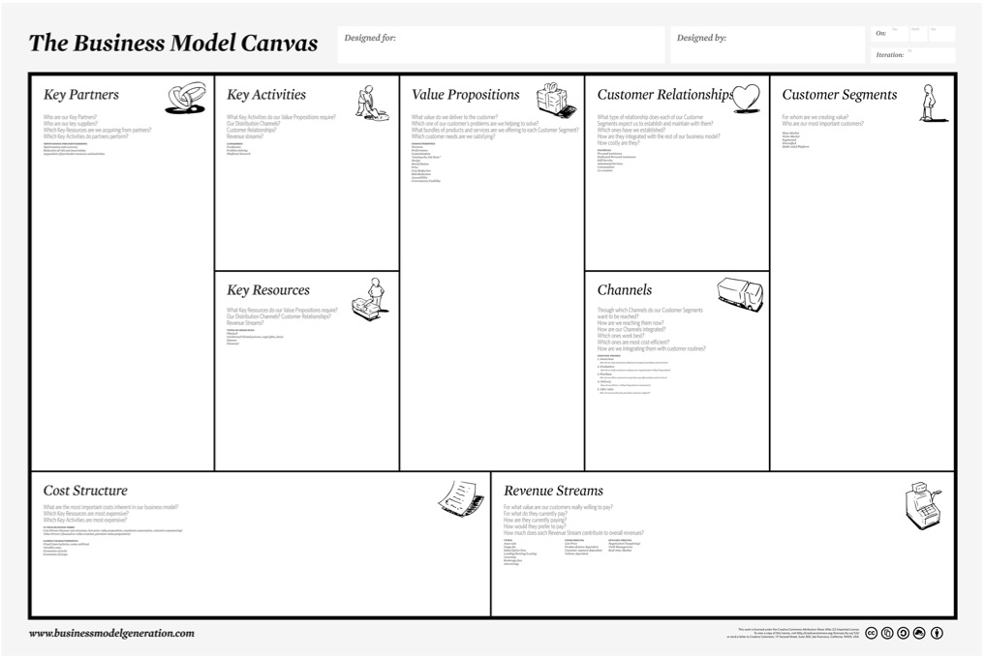

Slide 8
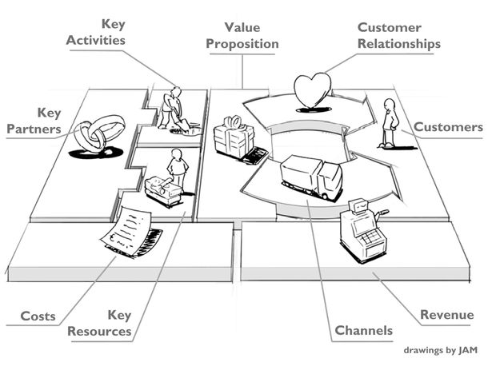
Business Model Canvas

Slide 9
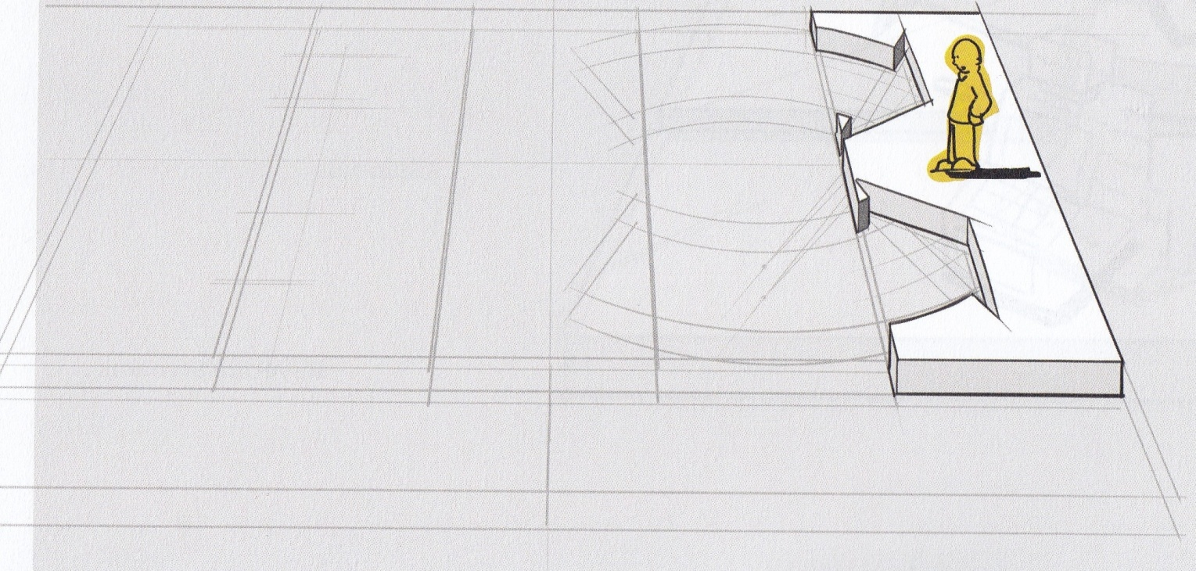
Customer
Segments (CS)
The Customer Segments building block defines the different groups of people or organizations an enterprise aims to reach and serve

Slide 10
Type of Market
Niche market
Multi-sided Markets
Mass market
Diversified
Segmented

Slide 11
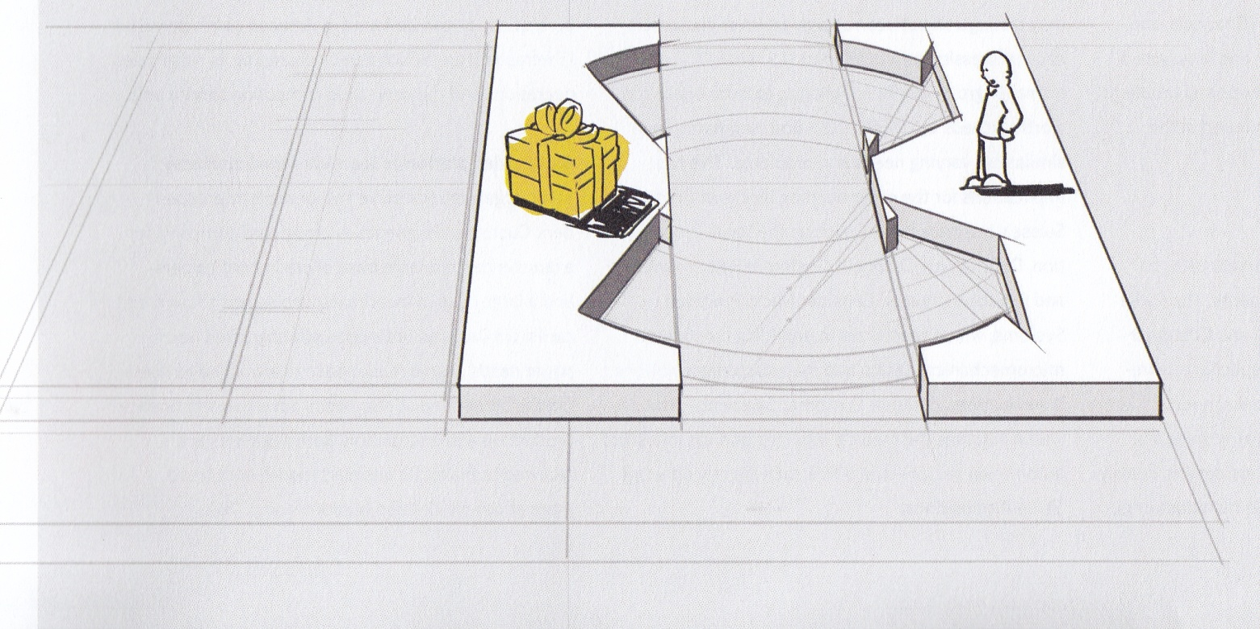
Value Proposition (VP)
The Value Propositions building block describes the bundle of product services that create value of a specific Customer Segment

Slide 12

What Value do We Deliver to The Customers?
Convenience/usability
Accessibility
Risk reduction
Cost reduction
Price
Brand/status
Design
“Getting the job done”
Customization
Performance
Newness

Slide 13
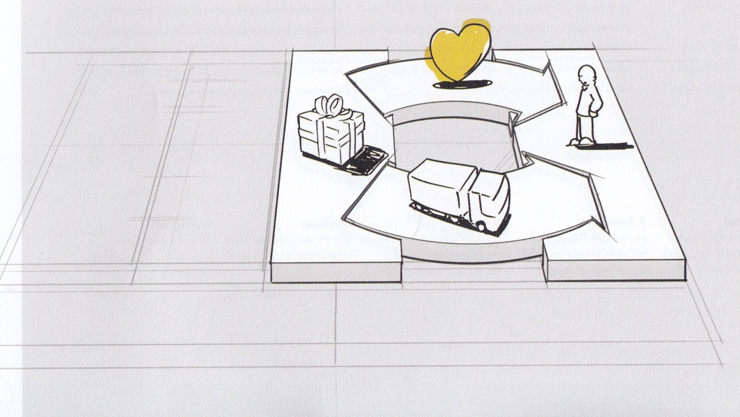
Customer Relationships (CR)
The Customer Relationships building block describes the types of relationship a company establishes with specific customer segments

Slide 14
Type of Relationship of Customer Segments
Personal assistance
Dedicated personal assistance
Self-service
Automated services
Commu- nities
Co-creation

Slide 15
Creative
Thinking
A way of looking at problems or situations from a fresh perspective that suggests unorthodox solutions (which may look unsettling at first).
Creative thinking can be stimulated both by an unstructured process such as brainstorming, and by a structured process such as lateral thinking.

Slide 16
Types of
Creative Thinking
Artistic Creativity Your job title doesn’t need to be “artist” for your work to have an artistic element. Perhaps you arrange retail displays for maximum impact or shape the treadway of an enticing hiking trail. Other jobs are sometimes assigned specifically to self-described artists, but if yours is a smaller company, the task might fall to whomever agrees to do it.
These tasks include designing logos, writing advertising copy, creating the packaging for a product, or drafting a telephone script for a fundraising drive.
Creative Problem-Solving
Creative problem-solving stands out as innovative. A creative problem solver will find new solutions, rather than simply identifying and implementing the most appropriate standard solution. You might brainstorm new ways to cut energy use, find new ways to cut costs during a budget crisis, or develop a litigation strategy to defend a client. All creative.

Slide 17
Example of
Creative Thinking
In Workplace
Brainstorming at a staff meeting to set a strategy for the next year
Coming up with new procedures to improve quality
Composing a new fundraising script for volunteers
Composing dialogue for a television or radio commercial
Constructing a research model to test a hypothesis
Creating the packaging for a product
Designing a logo
Devising a computer program to automate the billing process
Generating themes for a fundraising campaign
Identifying ways to cut costs during a budget crisis
Increasing staff productivity by devising performance incentives
Pitching retail products to customers in an innovative way
Proposing a new look for a clothing line
Proposing behavioral changes for a patient who is overweight
Suggesting a way to improve customer service
Writing compelling copy for a print or online advertisement

Slide 18
Creative
Problem Solving
Creative problem solving isn't just brainstorming, although that's what many people may associate it with. It's actually a well-defined process that can help you from problem definition to implementing solutions,
- Jeffrey Baumgartner -

Slide 19
7 Steps of Creative
Problem Solving
Clarify and identify the problem
Research the problem
Formulate creative challenges
Generate ideas
Combine and evaluate the ideas
Draw up an action plan
Do it! (implement the ideas)

Slide 20
7 Steps of Creative
Problem Solving
Clarify and identify the problem
Using 5 whys:
Why is it a problem?
Why the goal should be achieved?
Why ...
Why...
Why...
Using more questions the help clearly define the problem

Slide 21
7 Steps of Creative
Problem Solving
Research the problem
The next step in CPS is to research the problem in order to get a better understanding of it.
Use the Search Engine to find more related information
Libraries to get deeper info
Friends, colleagues and partners.
Formulate creative challenges
A creative challenge is basically a simple question framed to encourage suggestions or ideas. (In what ways might I [or we]…?” or “How might I…?” or “How could I…?”)
Creative challenges should be simple, concise and focus on a single issue
Trying to generate ideas that solve both challenges will be difficult and, as a result, will stifle idea generation.
Creative challenges should not include evaluation criteria.

Slide 22
7 Steps of Creative
Problem Solving
Generate Ideas
Write down every idea that comes to mind. Even if the idea is ludicrous, stupid or fails to solve the challenge, write it down.
Note: Brainstorming does not need to occur at your desk.
Combine and Evaluate the Ideas
Go through the ideas. Related ideas can be combined together to form big ideas (or idea clusters).
Since the idea is business related, you may need to do a business case, market research, build a prototype or a combination of all of these.
Also, keep in mind that you do not need to limit yourself to one winning idea. Often you can implement several ideas in order to solve your challenge.

Slide 23
7 Steps of Creative
Problem Solving
Draw Up an Action Plan
Draw up an action plan with the simple steps you need to take in order to implement your ideas. Ideas that involve a lot work to implement can be particularly intimidating.
Do It!
Take your action plan and implement your idea.

Slide 24
What is Market Research?

Slide 25
Market Research
Definition: The process of gathering, analyzing and interpreting information about a market, about a product or service to be offered for sale in that market, and about the past, present and potential customers for the product or service; research into the characteristics, spending habits, location and needs of your business's target market, the industry as a whole, and the particular competitors you face .
“Marketing research is systematic problem analysis, model building and fact-finding for the purpose of improved decision-king and control in the marketing of goods and services”
- Phillip Kotler -

Slide 26
Market Research
Vs Marketing Research
Marketing research is a broader term including market research.
Marketing research is concerned with all the major functions of marketing.
Market research is primarily concerned with knowing the capacity of the market to absorb a particular product.
Marketing research is not only concerned with the jurisdiction of the market but also covers nature of the market, product analysis, sales analysis, time, place and media of advertising, personal selling and marketing intermediaries and their relationships etc.

Slide 27

Objective of
Market Research
To link the consumer with the company through information to know more about him.
To investigate the real needs and requirements of customers.
To search for and analyse information that can be used for evolving some marketing decision alternatives and finally arriving at the best alternative.
To suggest necessary changes in the goods and services in order to meet the market demands.
To find out reasons for slowly loosing market share, and to identify ways and means for strengthening company’s position in the market, within and outside the country.
To identify opportunities and threats in the external environment of the company.
To know about the reactions of the people in the market about the existing or newly introduced products of the company.
To know in advance what kind of target markets exist in the economy where the company may launch its products as an innovation in the line.

Slide 28
The Benefits of Market Research

Slide 29

Benefits of Market Research
Understand where your customers are.
For instance, If you are planning on opening a coffee shop somewhere, it is important to recognize that the primary market you’ll serve will largely be a function of the footfall in that area.
Given the intense competition, for what is essentially a commodity offering, people do not travel far, so your addressable market will largely be a local one.

Slide 30

Benefits of Market Research
Estimate the size of the market you can serve.
Once you obtain an assessment of the size of the market that you can realistically target, you can then ensure that you have commensurate resources in place.
If you do intend to seek external investment, the size of the market will be of significant interest to prospective investors and the level of investment they will consider.
With a coffee shop, the market size will be a combination of people residing within say a square KM of the premises, married to the footfall or passing traffic. One easy way to get some plausible estimates for the market size is to do some primary market research.

Slide 31


Benefits of Market Research
Be clear on what your customers require.
It is important to recognize the different requirements of different customer groups.
Continuing the example above, the Customers of coffee shops at a busy train station may simply want a fast service as a key element of the offering.
They will probably consume ‘on the go’ so a simple kiosk may offer the best return. Customers in a coffee shop in the suburbs may want somewhere to spend some time. Some will place a high value on wifi access, others on the ability to fit a buggy in the door. While the core product is the same, the service offering can vary greatly. Having a clear sense of your different customer groups and their requirements will help you meet the needs of the different niches profitably.

Slide 32

Benefits of Market Research
Create a marketing plan to target them effectively.
Location is everything for coffee shops, so this will be a key element of your business plan. Once that has been decided, external branding and signage will help you communicate the offering to the market.
The internal set up of the store will also signal the markets catered for. Listing in local business directories, handing out flyers and placing local newspaper adverts will also help create brand awareness. Social media will also increasingly play a role as the adoption of smart phones continues apace, and users increasingly rely on geo-targeting applications to find services they need while on the move.

Slide 33
Market Research Process

Slide 34







The Process
Problem
Identification
Develop
the Approach
Research
Design
Execute!
Data
Analysis
Data
Collection

Slide 35
The Process
Identify and define the problem.
We should identify the key issues we expect to be able to solve.
This step should also include clearly defined objectives.
Develop the approach.
In this step, we need to establish a budget, understand influencing factors such as the environment or economy, decide on sampling and survey methods, and formulating hypotheses.
Research design.
Designing a survey or questionnaire is considered the most important step in any survey process. Question design takes a lot of thought and time. We like to say, “If you put garbage in, you’ll get garbage out.” This means that if the questions are bad, the data will be bad as well. During the survey research design, keep in mind sampling methods and data analysis factors you intend to use.

Slide 36
The Process
Collect the data.
Don’t forget to test the survey before to ensure we’re fielding the correct data.
Analyze the Data.
The types of analysis we planned to perform on the collected survey data should have been decided in earlier steps. We should actually perform the survey analysis after the data were collected. Analysis can be performed using survey analysis tools like office programs, such as Excel, or more advanced programs such as SPSS – the complexity of the questions will determine this.
Report, Present, Take Action.
The final step in the market research process is to present the survey research findings and draw conclusions.

Slide 37
Market Research Flaw
Market Research is Not Fact-Finding
Managers and business decision-makers may not always hold informed perspectives with regard to market research. For some managers, who have limited exposure to research design and scientific theoretical background, market research is a fact-finding endeavor, at best.
When market researchers return with the deliverables that have been requested, often after protracted protest and attempts to explain the inadequacies of such a misconceived plan, they are often discouraged.
You Get What You Pay For - Even in Market Research
The caliber of market researchers, as in most professions, will reflect their perceived value to the company that hires them. When market researchers receive low pay and market research is seen as basically a clerical activity, the research outcomes might not as accurate as it was supposed to be.

Slide 38
References
Aulet, Bill.(2013). Disciplined Entrepreneurship. John Wiley & Sons, Inc., Hoboken, New Jersey. ISBN: 978-1-118-69228-8.
http://www.yourarticlelibrary.com/marketing/marketing-management/market-research-meaning-definition-and-objectives-of-market-research/27947
https://articles.bplans.com/the-benefit-of-market-research/
http://www.innovationmanagement.se/imtool-articles/the-basics-of-creative-problem-solving-cps/
https://www.thebalance.com/creative-thinking-definition-with-examples-2063744

